Slide 1
Cloth
Team Elephant
Aaron Tse
Jeffery Oduro
Kevin De Asis
Ondra Chan

Slide 2
Introduction
Cloth like materials are objects that we interact with in our daily lives. Therefore, it is an important to understand how to create realistic looking cloth that interact with the world as we would expect it to.

Slide 3
Task Allocation
Aaron – Overview, Collisions, Tearing, Compiling the Presentation
Jeff – Capes and External Forces
Kevin – Garment Maker, Making clothes
Ondra – Creases/Folds and Cloth materials

Slide 4
Overview

Slide 5
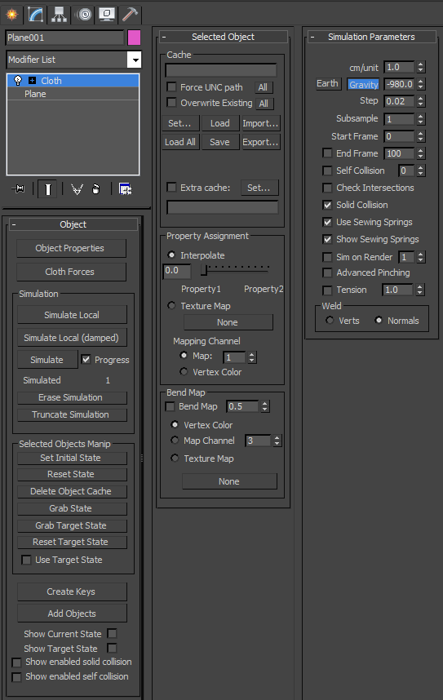
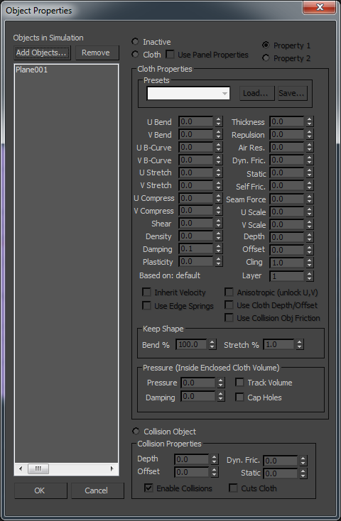
The general cloth rollout
Object Properties rollout

Slide 6
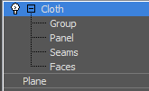
Additionally, there are 4 subgroups that you can use to modify your cloth.
Group – Used to group and modify vertices
Panel – Used to change cloth properties of a given section of cloth
Seams – Used to create and alter seams in the cloth
Faces – Used to modify the faces during local simulation

Slide 7
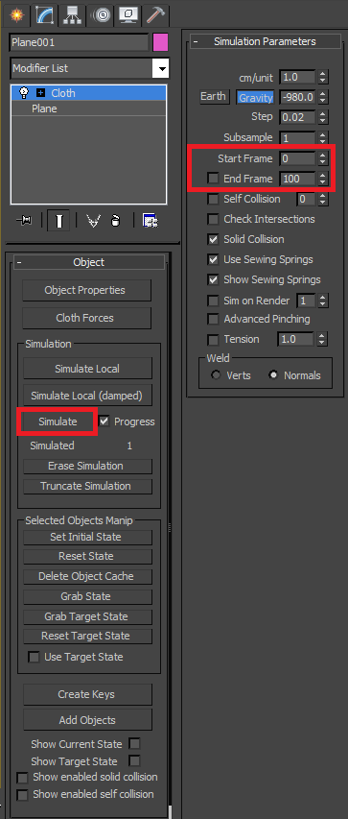
-After setting up your scene, configure the number of frames that you would like to simulate the cloth animation over and hit simulate.
-You must click on “Erase Simulation” before re-doing your simulation, otherwise nothing will happen.
-Alternatively, you can click “Simulate Local” to create the simulation without recording the frames.

Slide 8
Collisions and Tearing

Slide 9
Collisions - General
Collisions of cloth accomplished easily as demonstrated in the class demo
Steps:
1. Create cloth object and collision object
2. Apply cloth modifier to cloth object (after preprocessing)
3. Open object properties and set cloth object to “cloth” and define properties
4. Add collision object (still in object properties) and set as collision object, modifying properties as desired (Ensure, “Enable collisions” is checked)
Not always smooth

Slide 10
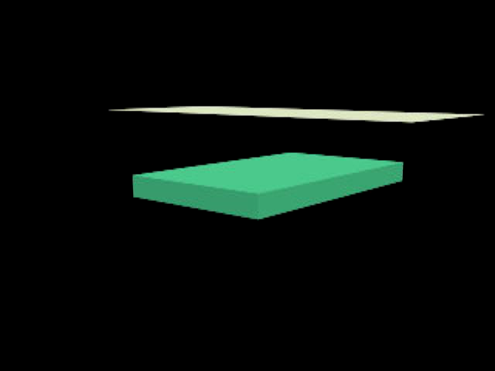
Plane with 10 x 10 segments

Slide 11
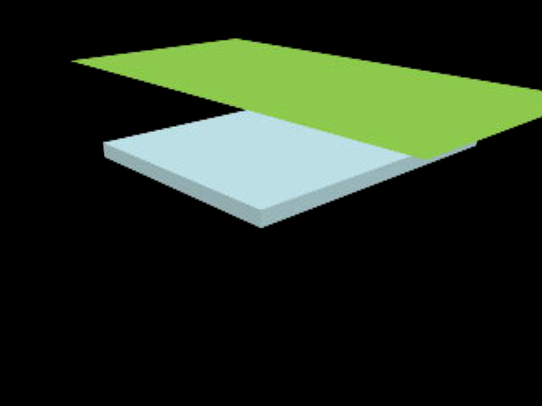
Plane with 25 x 25 segments

Slide 12
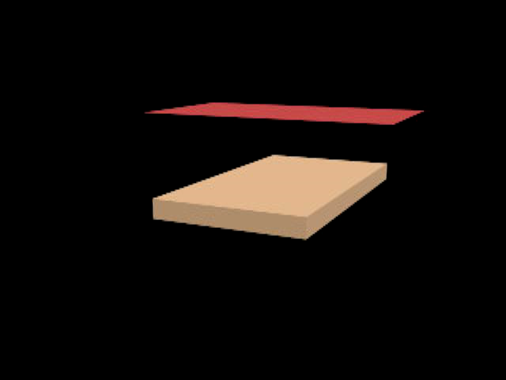
Plane with 100 x 100 segments

Slide 13
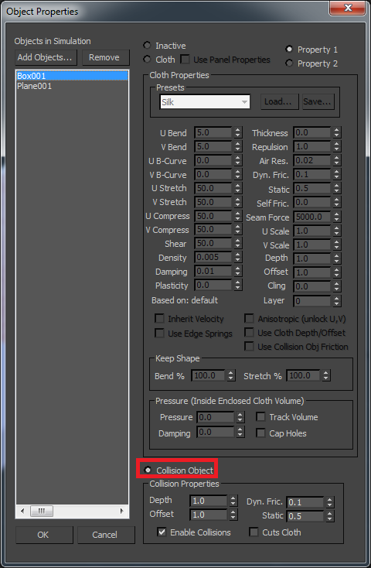
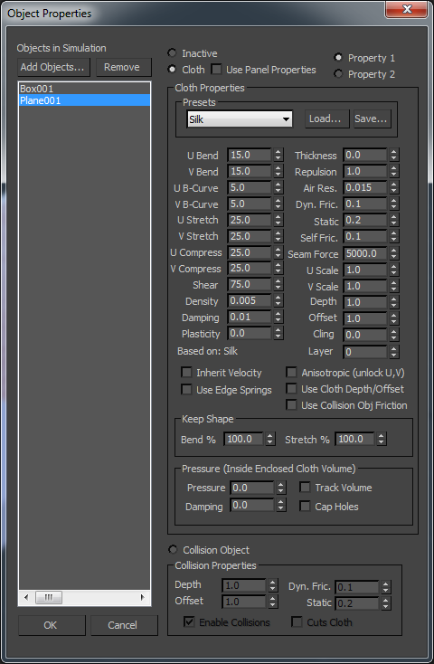
Setup for Collision Object
Setup for Cloth Object

Slide 14
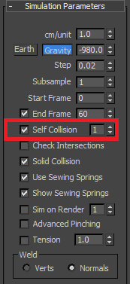
Self Collisions (Cloth on Cloth)
Sometimes, you have 2 cloth objects but you can’t set one of them to a collision object
To handle this, simply turn on the self collisions option
Useful in situations such as T-shirt/pants interaction

Slide 15
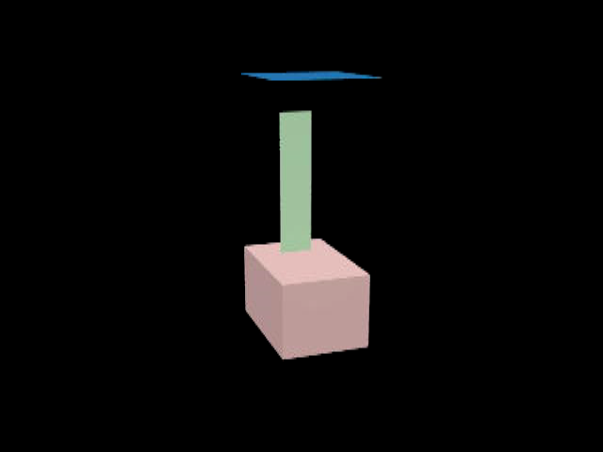
Comparison
Without Self-Collide
With Self-Collide

Slide 16
Tearing
Cloth can simulate tearing in 3ds Max with relative ease as long as some conditions are met
2 Conditions must be met:
1. Significant force is applied, or a collision with an object that can “cut cloth”
2. A tear location is specified on the cloth object
Vertices
Seams
Welding 2 cloth objects together

Slide 17

Tearing a Plane

Slide 18
Steps
1. Create a plane and convert to cloth object
Do preprocessing such as increasing segments, changing the tessellation etc. before converting
2. Select the “Group” sub-object
3. (Optional) Select vertices and create a group and use the “Preserve” operation on it (these ones will not move)
4. Select separate vertices where you want the tear to be and click “Make Tear” (It will automatically create a group for you)
5. Adjust parameters and repeat steps 4+5 as needed

Slide 19
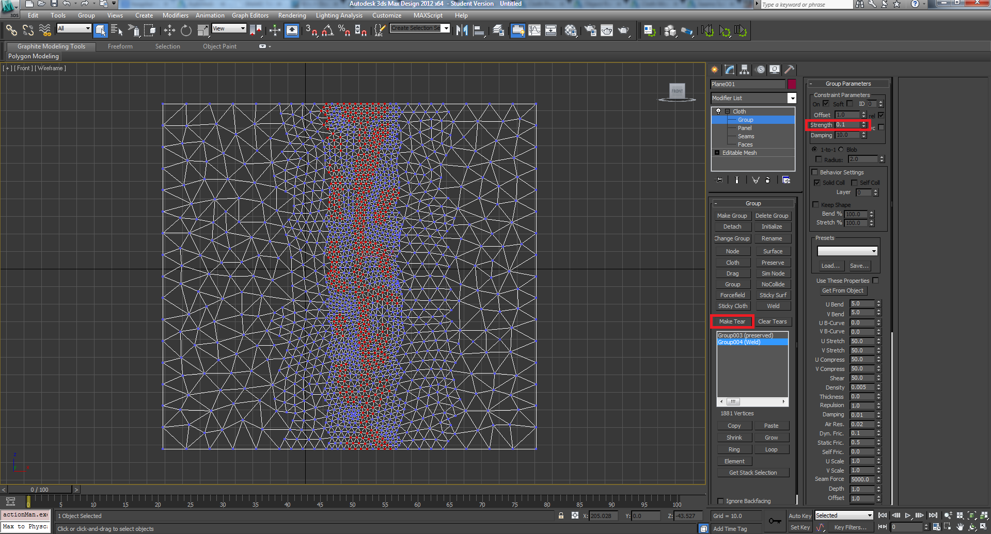

Slide 20
Using an Object to Cut
While it is possible to simply use gravity to tear cloth, at times, it becomes necessary for an object to be able to cut the cloth.
Requires one extra step: Enable “Cut Cloth” on collision object

Slide 21
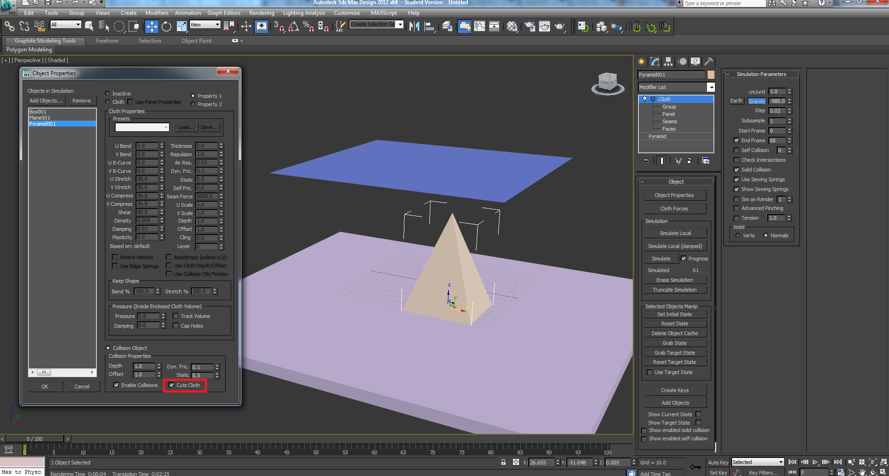

Slide 22
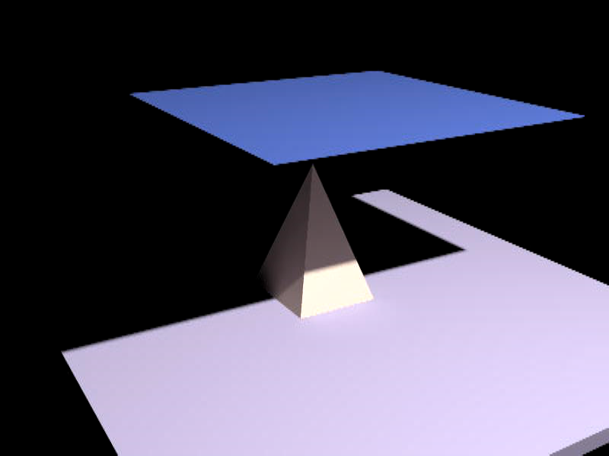
Puncturing

Slide 23
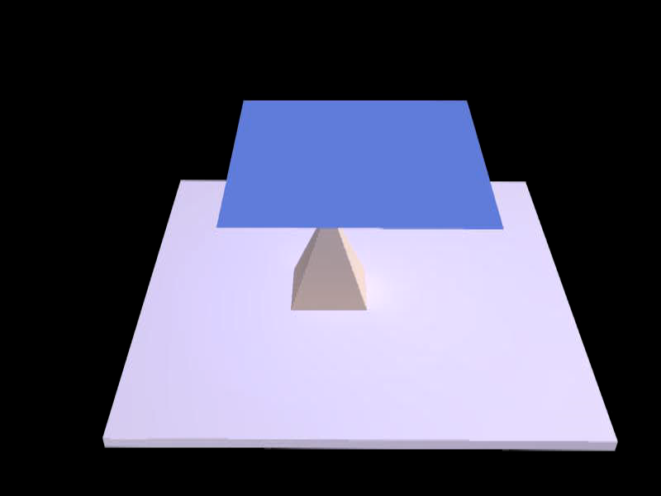
Consequences of Disabling “Cut Cloth”

Slide 24
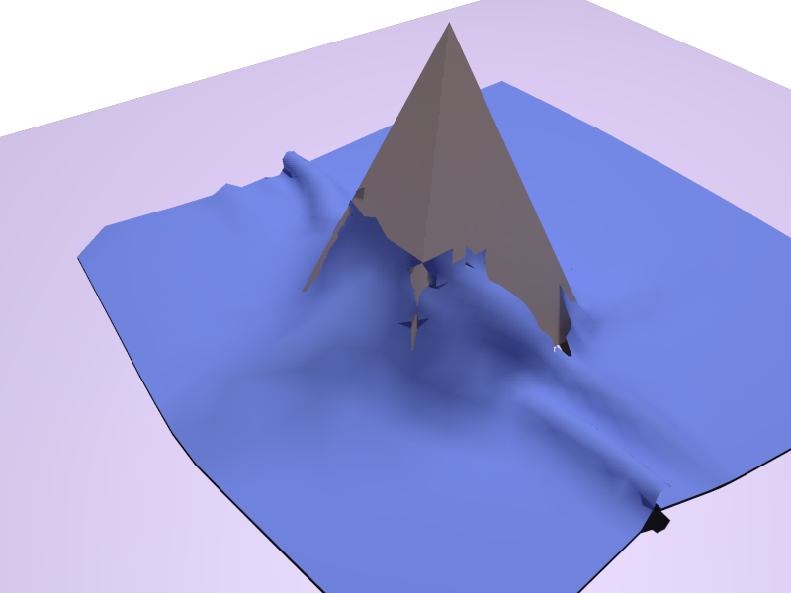
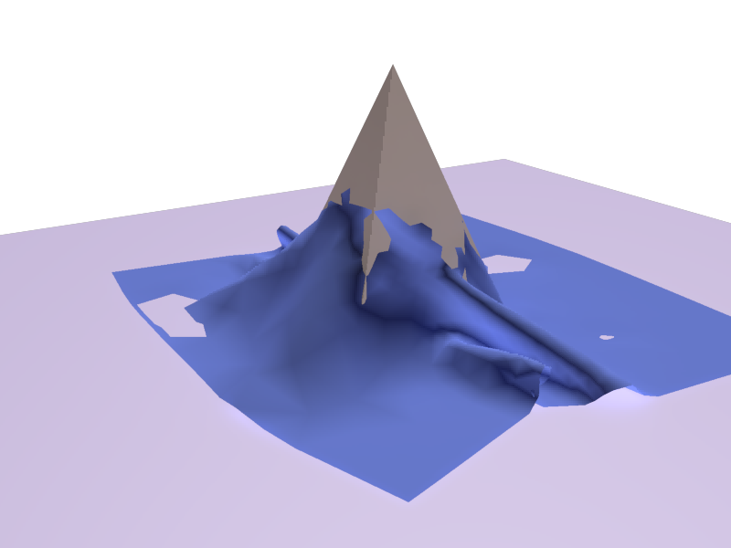
Result
With cut
Without cut

Slide 25
Remarks
Collapsing the cloth modifier bakes in the position of the cloth, not the animation
When defining the tear location, be careful of isolating tiny sections of your cloth (unless your goal is to make your cloth disintegrate)
Mess around with the object properties (or don’t)

Slide 26
References
https://www.youtube.com/watch?v=1oYdGSmcflc
http://knowledge.autodesk.com/support/3ds-max/learn-explore/caas/CloudHelp/cloudhelp/2015/ENU/3DSMax/files/GUID-1663898B-7C53-4123-9D54-7B7EE843FB92-htm.html

Slide 27
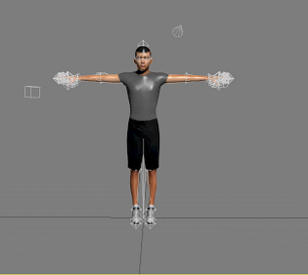
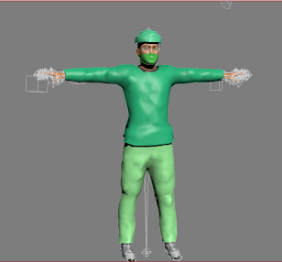
Before & After Creating Cloth and Garment Modifier
Autodesk Character Generator

Slide 28
Video
http://youtu.be/xeC1A8T8Lqw

Slide 29
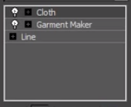
Least effort with only 3 modifiers

Slide 30
Quick Start
Create a silhouette of your garment using lines
Make a copy of the silhouette and attach the original
Select all vertices and click break under geometry column
Add garment maker modifier
Rotate one of your panels to a complete 180 and put them behind your model
Click individual lines that are parallel and create seams
Increase tolerance for seams that are not symmetric

Slide 31
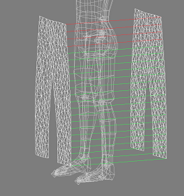
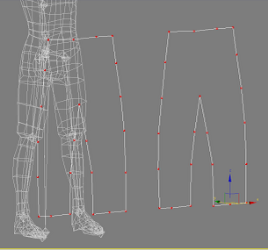
It should look like

Slide 32
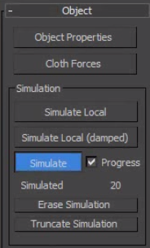
Simulation
Uncheck sewing springs
Under simulation properties
Click the set of vertices
For each seam and weld them
Easiest way to animate is
to turn it into a skin modifier

Slide 33
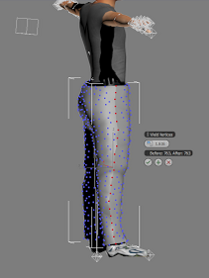
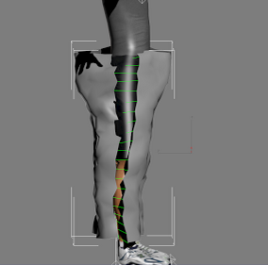
Finishing it off

Slide 34
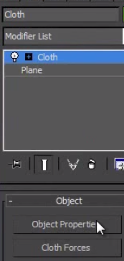
Cloth Modifier Object Properties

Slide 35
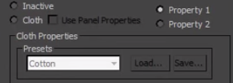
Object Properties
Choose your cloth and garment then check the cloth radio button. In presets you can choose the cloth type.

Slide 36
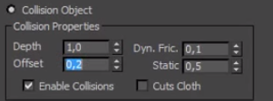
Object Properties
Then choose your model that deforms the cloth and garment. Then click the collision object radio button

Slide 37
Reference
https://www.youtube.com/watch?v=MEsRmPgmt-I
https://www.youtube.com/watch?v=7ccxNRmakY4

